Slide 1
CARDIOVASCULAR DISEASE
Prediction
Using Machine Learning

Slide 2

OUR TEAM
PREV
NEXT
Dr. Mubasher Shahzad
Tayyab Riaz

Slide 3
TABLE OF CONTENTS
1
2
3
4
5
6
PREV
NEXT
About the Disease
About Dataset
Data Preprocessing
The Actual Problem
Data set Info
Data cleaning
Data Splitting
Modal Training
Optimization & Accuracy
Splitting Of Data
Logistic Regression
Further Optimization and Accuracy of Modal

Slide 4

ABOUT THE DISEASE
1
PREV
NEXT
Why we Need ML

Slide 5
The Heart Disease
PREV
NEXT
Heart disease refers to several types of conditions that affect the structure and function of the heart. The most common type is coronary artery disease.

Slide 6
The Problem
PREV
NEXT
The World Health Organization has estimated 17.9 million deaths occur worldwide, every year due to Heart diseases. Half the deaths in the United States and other developed countries are due to cardiovascular diseases.

Slide 7
17,900,000
PREV
NEXT
Deaths Each Year

Slide 8
PREV
NEXT
Most heart diseases are highly preventable and simple lifestyle modifications(such as reducing tobacco use, eating healthily, obesity and exercising) coupled with early treatment greatly improve their prognoses.

Slide 9

Why We Need Machine Learning
PREV
NEXT
However, Doctors find difficulty to identify high risk patients because of the multifactorial nature of several contributory risk factors such as diabetes, high blood pressure, high cholesterol.

Slide 10
The Magic
Mrs. ML
PREV
NEXT

Slide 11

Why we need ML?
Why we need ML?
Due to such Reasons, scientists have turned towards modern approaches like Data Mining and Machine Learning for predicting the disease.

Slide 12

Why we need ML?
ML , due to its superiority in pattern detection and classification, proves to be effective in assisting decision making and risk assessment from the large quantity of data produced by the healthcare industry on heart disease

Slide 13

Heart...such a sentimental topic...and they say AI can't feel...
PREV
NEXT

Slide 14
About Dataset
2
PREV
NEXT
Husband Of ML

Slide 15
Framingham, Massachusetts
PREV
NEXT
1
2
The dataset is publically available on the Kaggle website, and it is from an ongoing cardiovascular study on residents of the town of Framingham, Massachusetts

Slide 16
Dataset Info
1
2
3
PREV
NEXT
Goal is to predict patient can have Heart Disease in next 10 Years or Not.
Total Observations in data are over 4000.
Total Features in Data are 16.

Slide 17
Features in Dataset
PREV
NEXT
Male
Age
1 for Male & 0 for Female
Age of Person
Current Smoker
Cigarette Per Day
1 if Person is Smoker & 0 if Not
Total Numbers Of Cigarettes Per day
BP medication
Prevalent Stroke
Whether or not the patient was on blood pressure medication
Whether or not the patient had previously had a stroke

Slide 18
Features in Dataset
PREV
NEXT
Prevalent Hyp
Diabetes
Whether or not the patient was hypertensive
Whether or not the patient was Diabetic
Total Cholesterol
Systolic blood pressure
Systolic blood pressure
Total cholesterol of a Person
Diastolic Bp
BMI
Diastolic blood pressure
Body Mass Index of a person

Slide 19
Features in Dataset
PREV
NEXT
Heart Rate
Glucose
Heart Rate of a Person
Glucose level of a Person
Ten Year CHD
Weather or not a Patient can have 10 Year Heart Disease

Slide 20
Data Preprocessing
3
PREV
NEXT
Data Cleaning

Slide 21
Data Preprocessing
PREV
NEXT
Missing Values
Handling Outliers
Duplicates
Dealing with All NULL Values
Check Whether Data has Any Outliers
Check whether Data has Duplicates

Slide 22
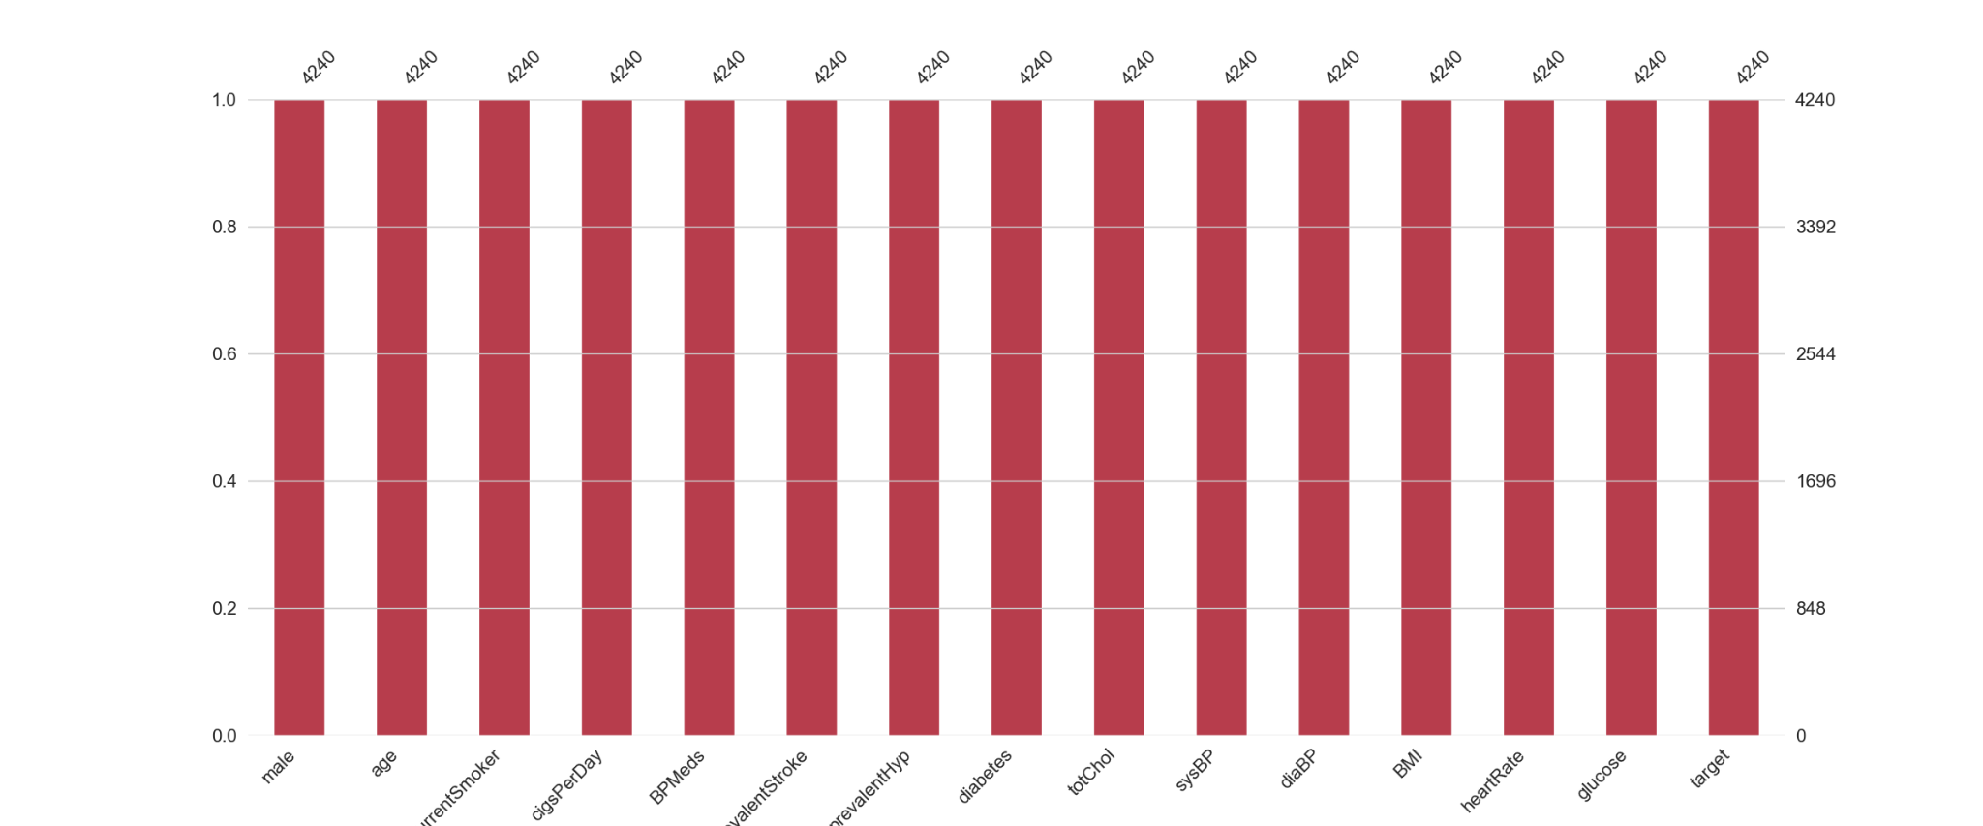
NaN Values Chart

Slide 23
Handling Outliers
PREV
NEXT
There is no any Outlier in My data

Slide 24

Duplicates
PREV
NEXT
There is no any duplicate value in dataset.

Slide 25
Dataset Summary
PREV
NEXT
What has
What not has
Missing Values
Biases In Data
Duplicates
Outliers

Slide 26
Data Splitting
4
PREV
NEXT
Training
Testing

Slide 27
Data Splitting
80%
PREV
NEXT
Training Data Vs Testing Data
80% data is for training & 20% data is for testing.

Slide 28
5
Modal Training
PREV
NEXT

Slide 29
Logistic Regression Model
PREV
NEXT
Hi ! I am
Logistic Regression
I trained Model on Logistic Regression Algorithm.

Slide 30

6
Optimization & Accuracy
PREV
NEXT

Slide 31
Optimization
Further Optimization Can be done If there is More data
PREV
NEXT

Slide 32
Accuracy
PREV
NEXT
Modal Gives accuracy of 85%

Slide 33
REFERENCES
PREV
NEXT
https://www.kaggle.com/datasets/aasheesh200/framingham-heart-study-dataset

Slide 34
THANKS!
Does anyone have any questions m.tayyab.riaz@outlook.com +92 370 577 80 82 Fast Nuces

